Slide 1

MFG 598: - Engineering Computing with Python
Fraud Detection In Credit Card Transactions
Kaushik Shankar (1225653286)

Slide 2

Introduction
Detection of Fraud in credit card transactions using Kaggle Dataset, consisting transactions made by credit cards in September 2013 by European cardholders.

Slide 3
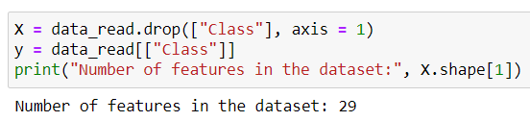
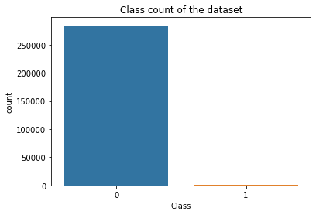
Dataset Analysis
The problem is binary classification of dataset:
Class 0 - non fraud transaction
Class 1 - fraud transaction
Dataset consists of 29 features.
There are no null values in the dataset.
The total number of transactions recorded in the dataset are 284,807 among which 492 are fraud transactions. The dataset is extremely imbalanced.
One of the ways to manage extremely imbalanced dataset is to downsample the majority class and use that to train the machine learning models.

Slide 4
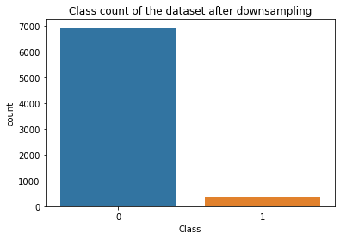
Pre-processing dataset
We split the dataset into test and train, 30 - 70 %.
Downsampling of majority class was done randomly. We randomly chose Class 0 data points such that the number of those data points was 20 times that of the Class 1 data points in training dataset.
We downsampled the majority class from two different initial datasets.
Downsampled from the training dataset.
Downsampled from training dataset where outlier points of features having low correlation with target removed.
We generated two downsampled train datasets consisting of 6900 Class 0, 345 Class 1 data points.

Slide 5
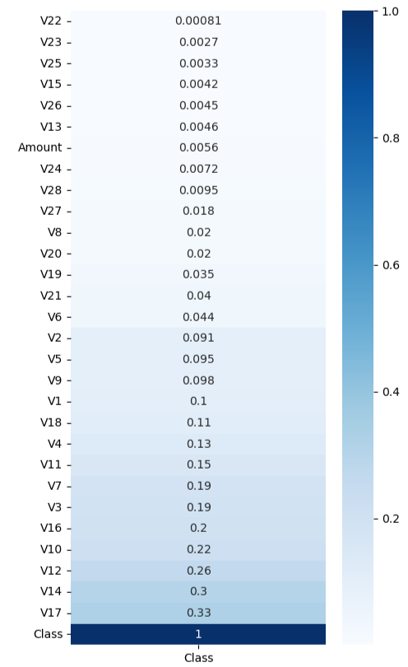
Outlier Detection and Normalization
Outliers were detected for the features that had low correlation with the target. This was achieved by performing univariate analysis.
We chose the least related 10 features: ['V22', 'V23', 'V25', 'V15', 'V26', 'V13', 'Amount', 'V24', 'V28', 'V27']
We used Interquartile Range of Detect method for the detection of the outliers.
The Method calculates 25th percentile (Q1) and 75th percentile(Q3)of the data points and finds the IQR = Q3 - Q1.
According to the method outliers are the points that lie below Q1 - IQR * 1.5 and Q3 + IQR * 1.5.

Slide 6
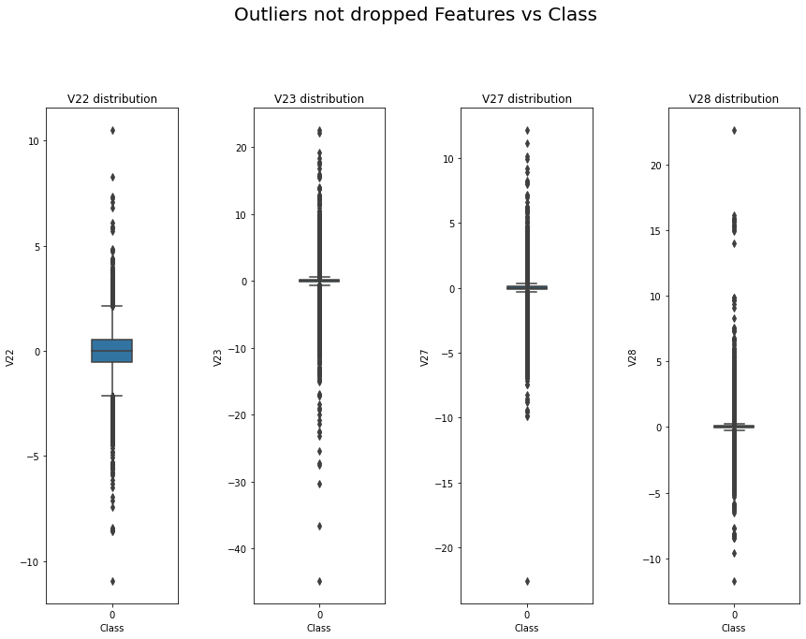
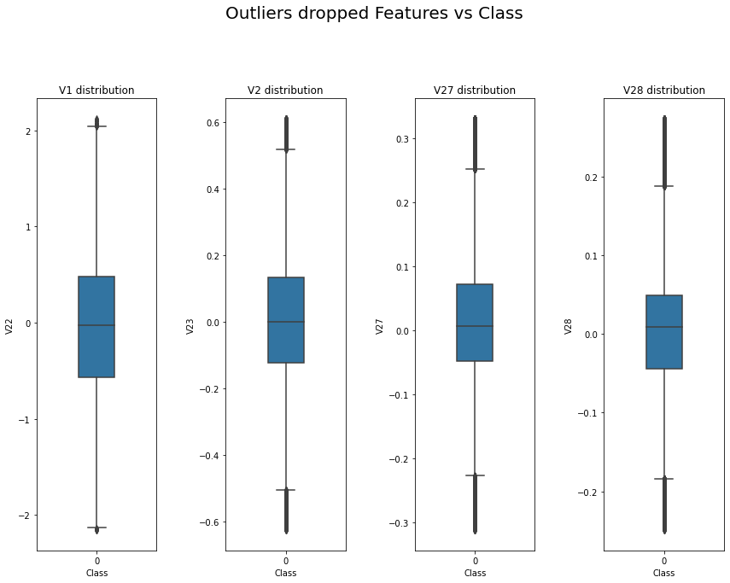
Above images show the comparison of the features in a box plot with and without the outliers removed.
We chose to use Robust Scaler method for Normalization because it is resistant to outliers and this dataset consists of lot of outliers and this method uses same technique as Interquartile Range of Detect.

Slide 7
Machine Learning Models Implementation
Machine learning models
Logistic Regression
Penalty - L2(to avoid overfitting)
Decision Tree
non-parametric
Random Forest
Estimators - 30
Machine learning models
K Nearest Neighbours
Neighbours - 6
Weights - ‘distance’
Support Vector Machine
Kernel - ‘rbf’
C - 2

Slide 8
Contd..
We trained 5 Machine learning models on 3 different dataset.
Dataset utilized for training
Original dataset (Class 0: 199019, Class 1: 345 )
Downsampled dataset consisting of outliers (Class 0: 6900, Class 1: 345)
Downsampled dataset not consisting of outliers (Class0: 6900, Class1: 345)
We used k-fold cross validation on downsampled dataset since it has less samples.
Here we used k = 5, so we trained 5 separate models of each using K-fold cross validation, where each model uses one speaker from the training dataset and the rest from the testing dataset.

Slide 9
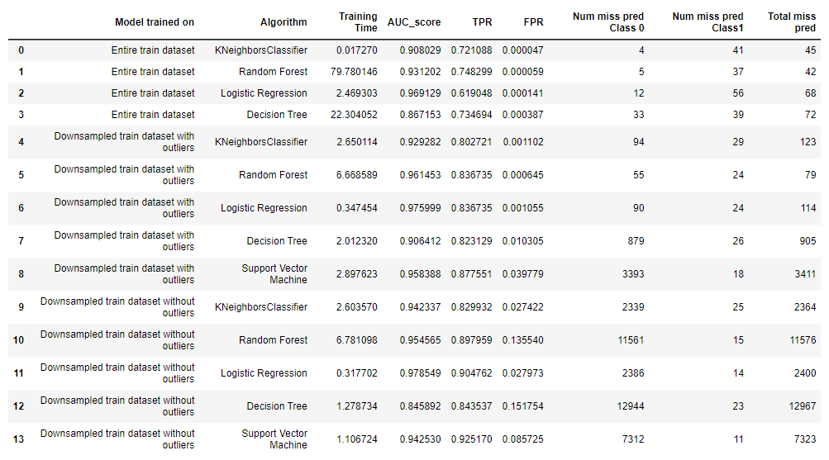
Results
Metrics chosen
AUC score
TPR
FPR
ROC curve

Slide 10
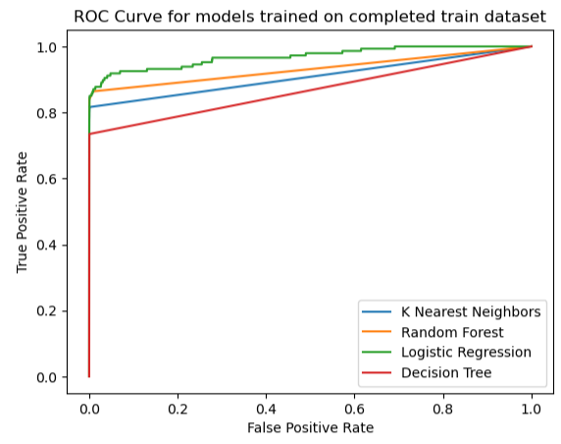
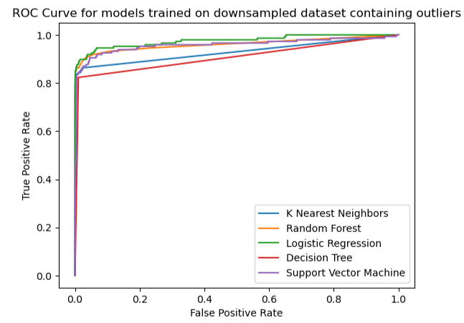
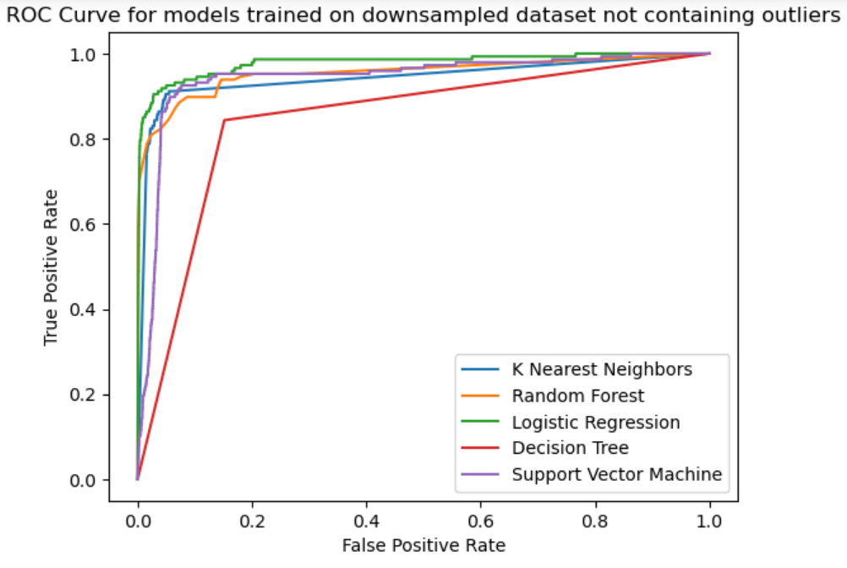
ROC Curves

Slide 11
Conclusion and References
Among all the models, Logistic Regression is good model with highest AUC score.
We also observed that the dataset has information in the outlier points.
For the future scope, the usage of ensemble methods will make the prediction of classes better.
https://arxiv.org/pdf/1904.10604.pdf
https://www.kaggle.com/datasets/whenamancodes/fraud-detection
https://developers.google.com/machine-learning/data-prep/construct/sampling-splitting/imbalanced-data

Slide 12
THANK YOU

